Slide 1
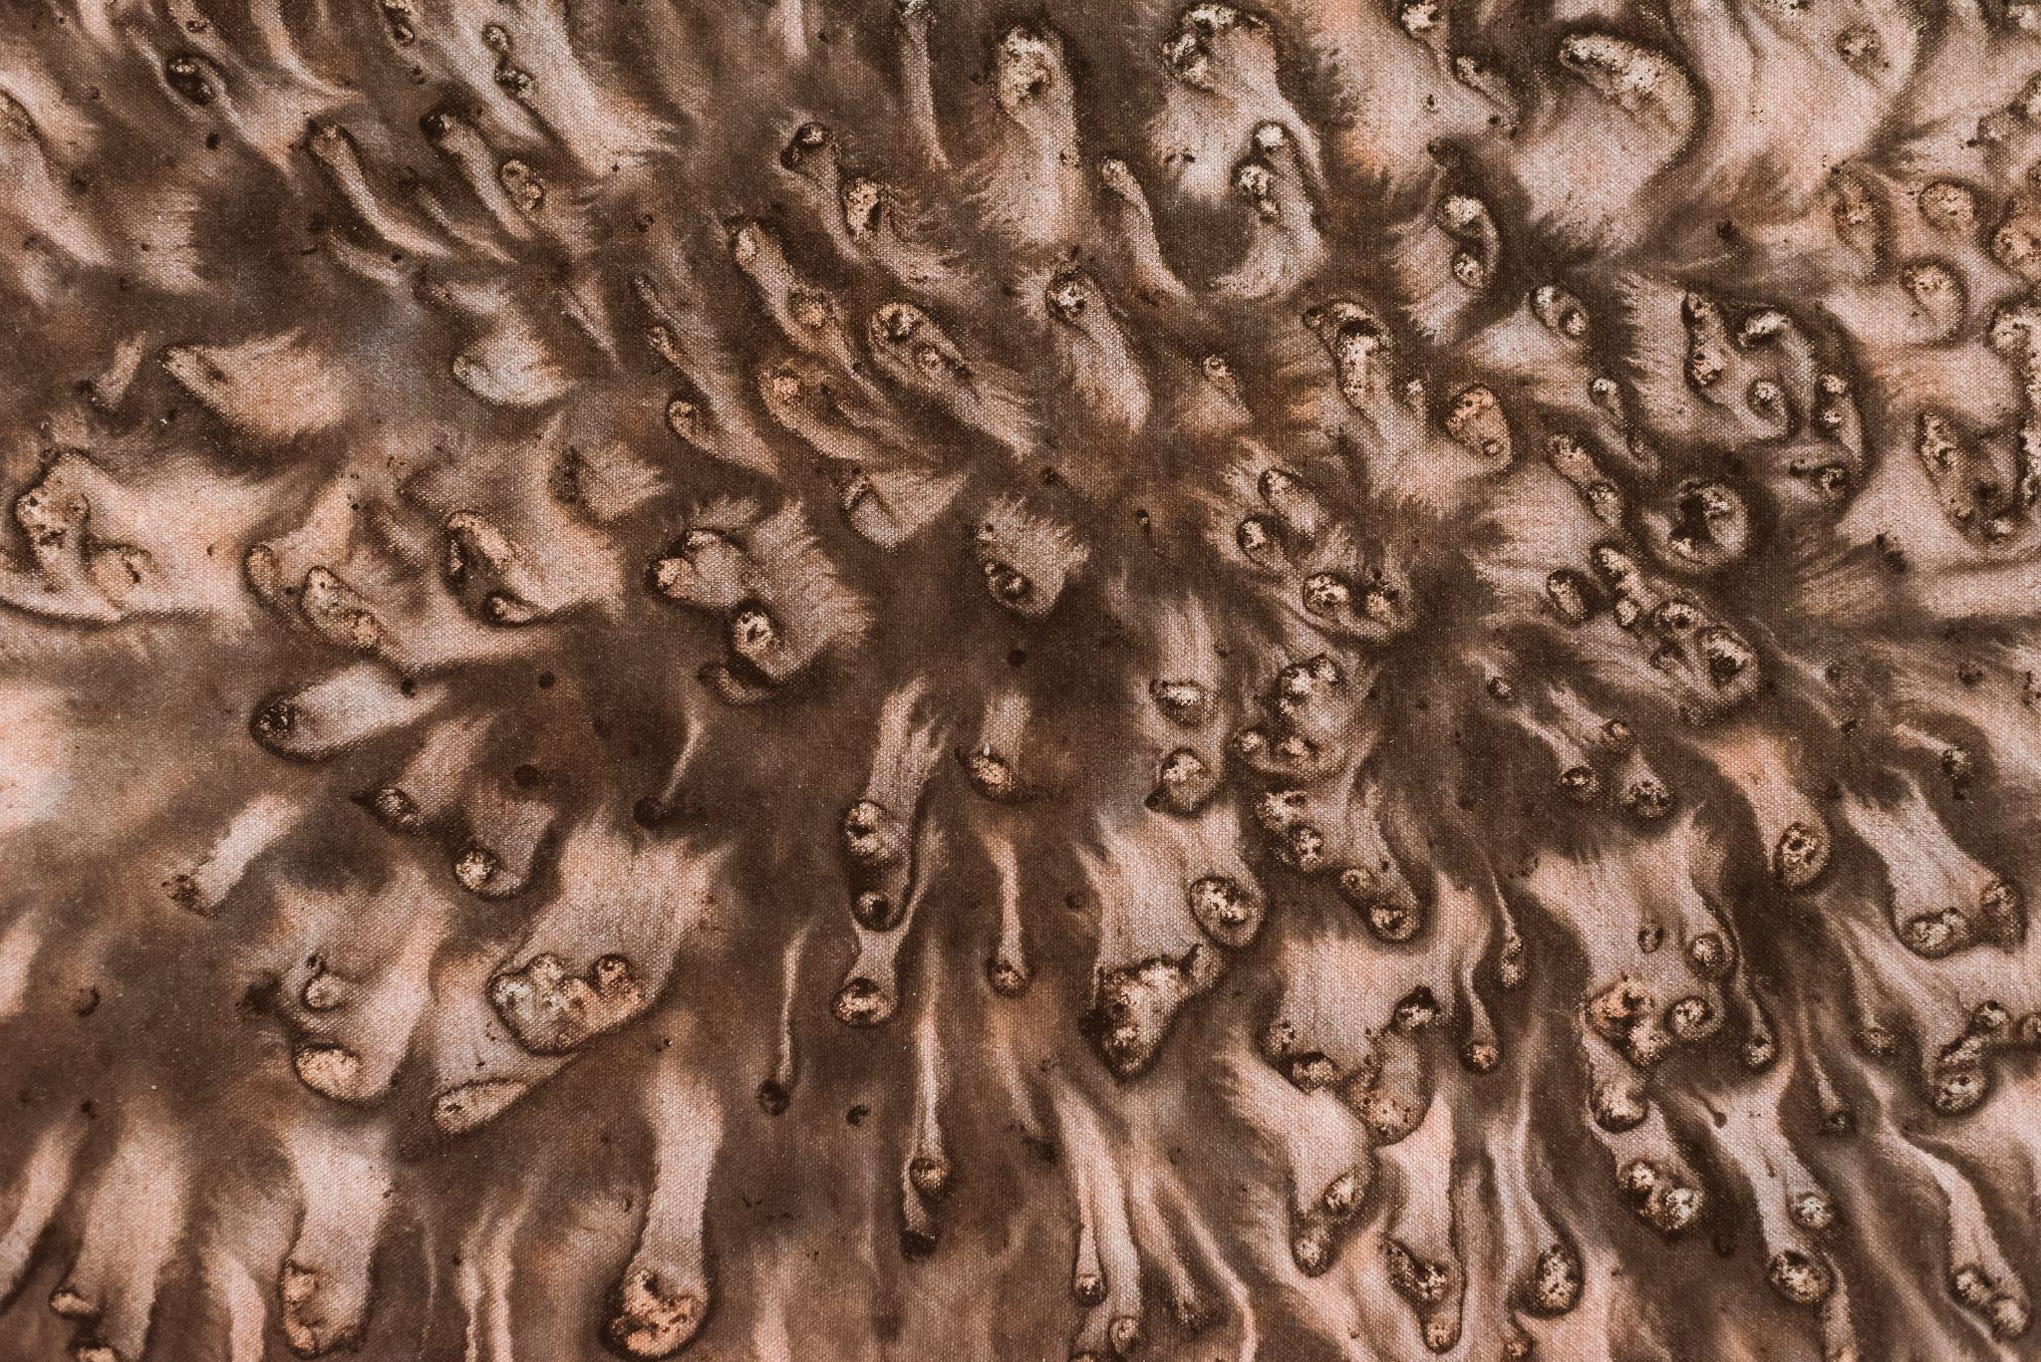
Elements of Art Spotlight: TEXTURE
With artwork by Master Shen-Long

Slide 2
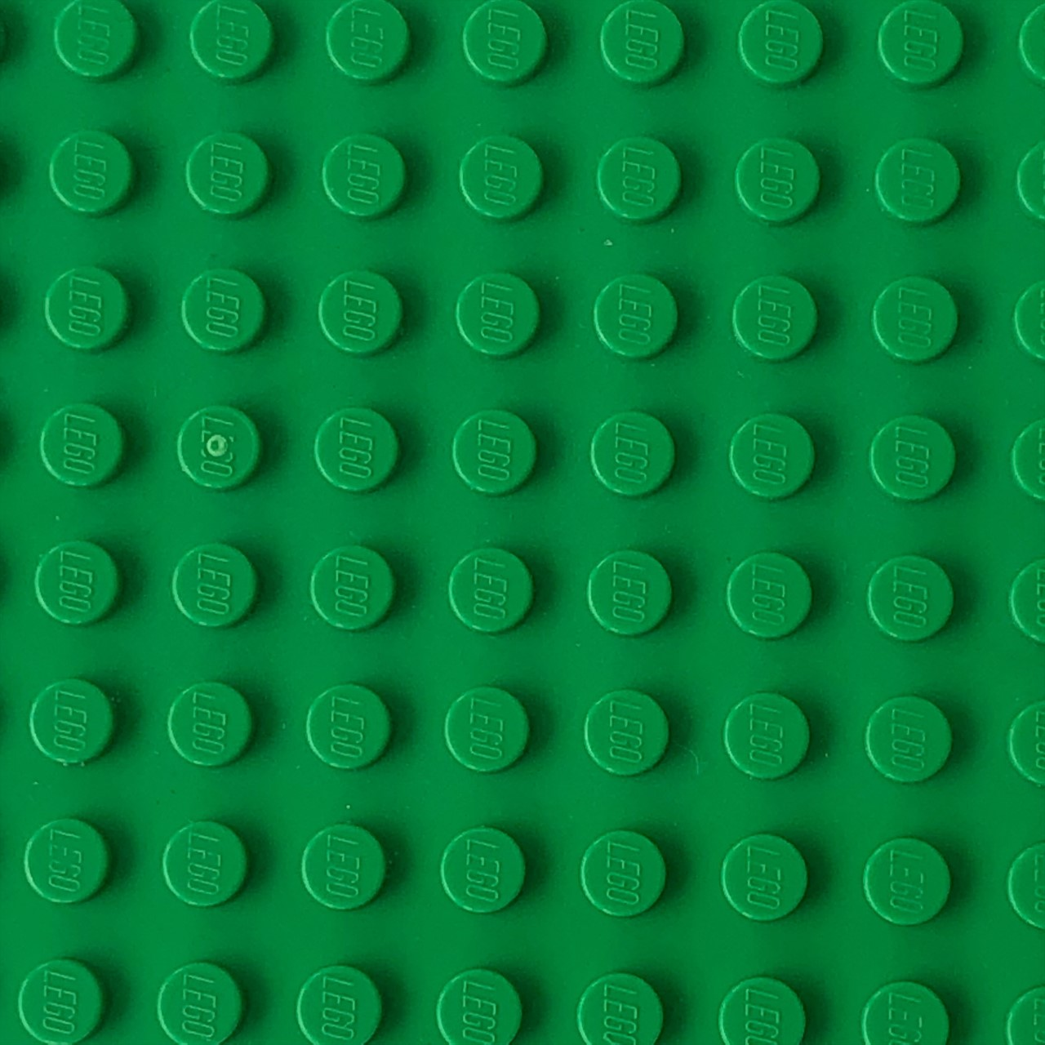
What is texture?
Texture is how a surface looks or feels.
What do you think this surface feels like?

Slide 3
This surface is bumpy!
Even though you can’t touch it, you can tell just by how the surface looks that it would feel bumpy.

Slide 4
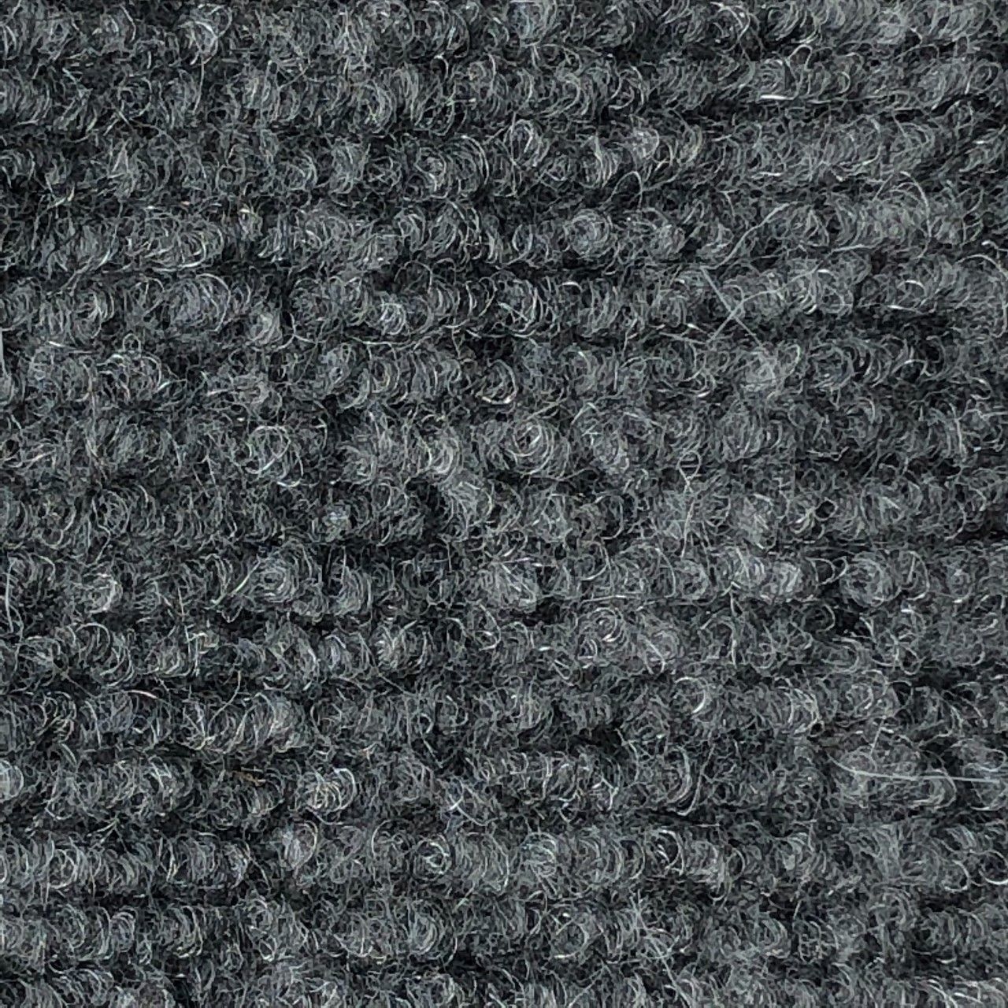
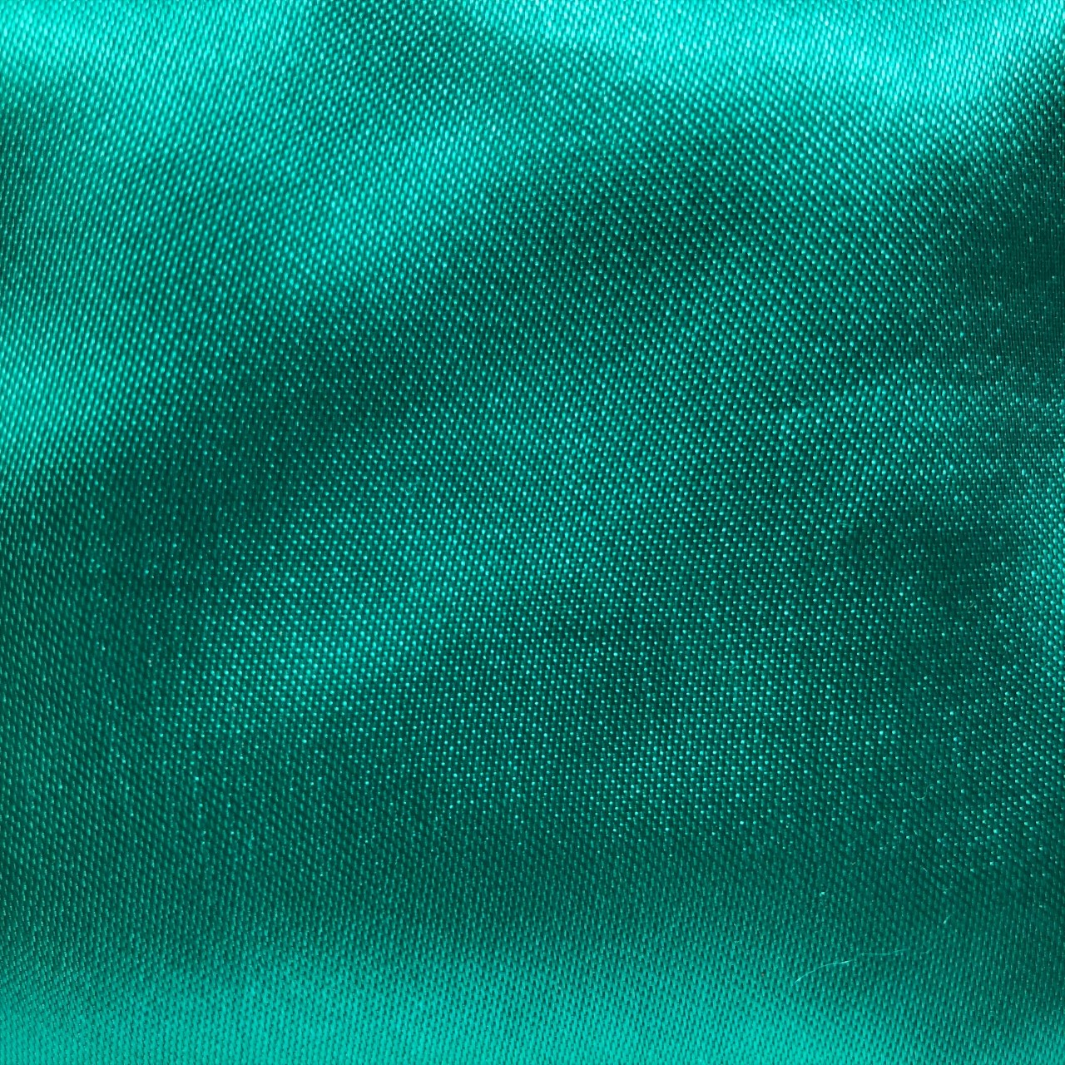
How would you describe these textures?
Possible texture words:
Smooth
Rough
Furry
Glossy
Scratchy
Silky
Pointy
Soft

Slide 5
Does art have texture?
Yes! Texture is one of the seven elements of art.
Artist create texture using different types of tools such as paintbrushes, stamps, chisels, or pencils.
Artist also create different textures by using techniques like painting several layers on top of each other or by making thin or bold marks.

Slide 6
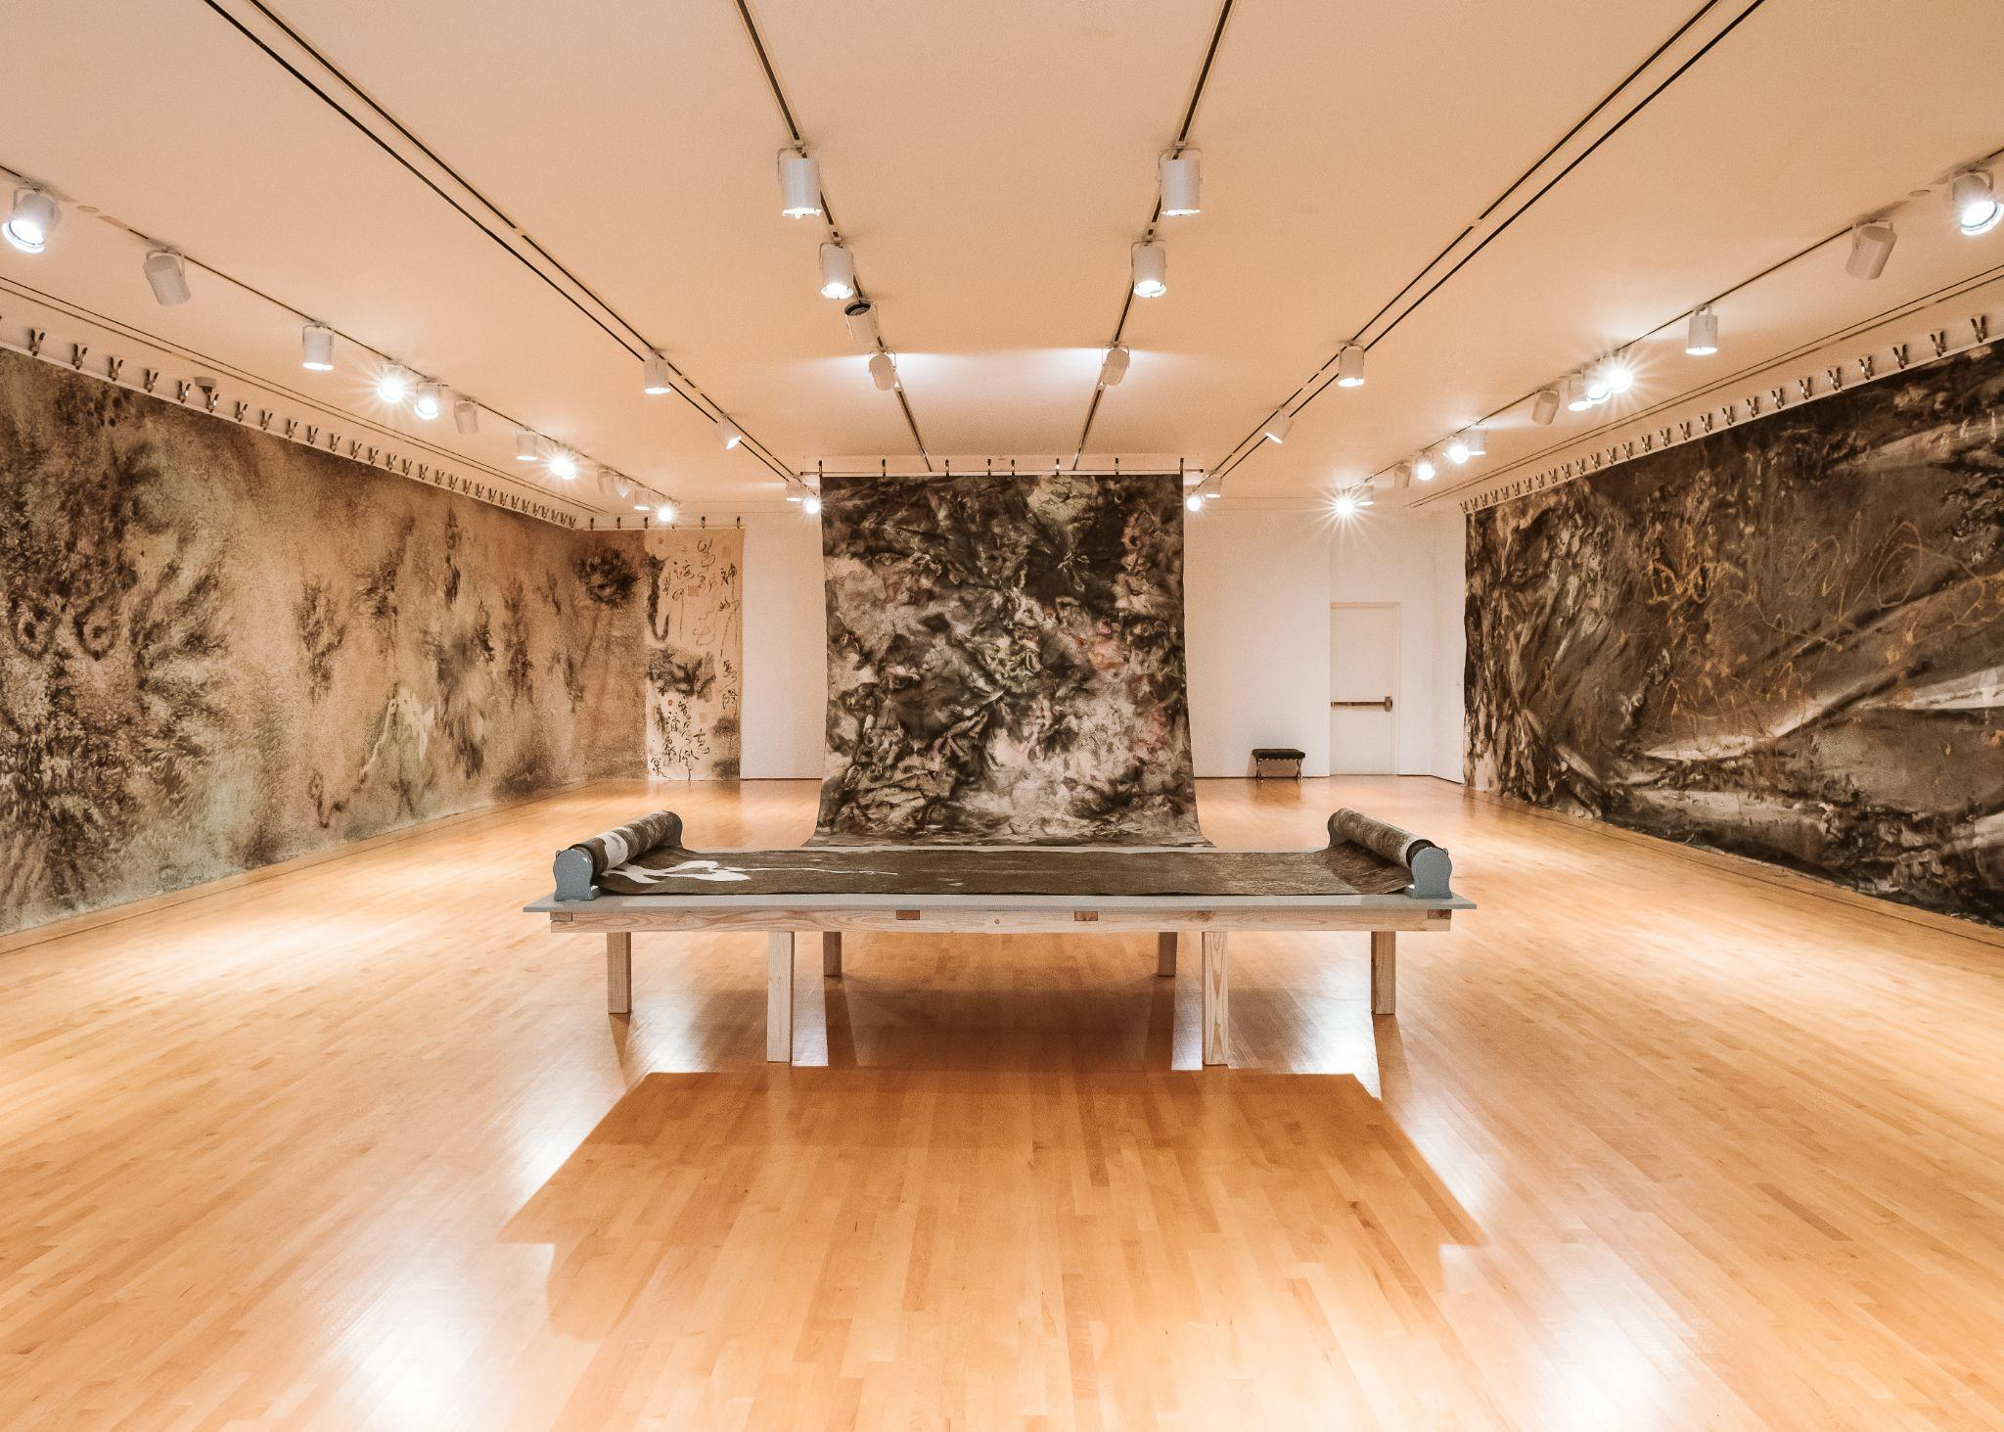
The artist Master Shen-Long creates many textures in his artwork!
Photo by Jessica Harrington, 2021

Slide 7
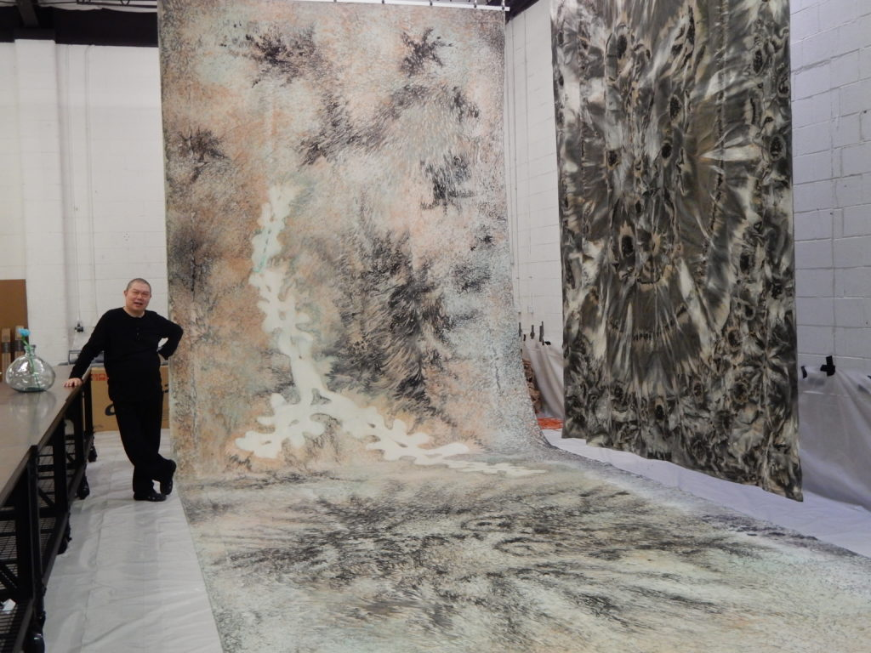
Master Shen-Long was trained in the classical Chinese literati tradition which includes painting, poetry, calligraphy, and seal carving.
Image from mastershenlong.com

Slide 8
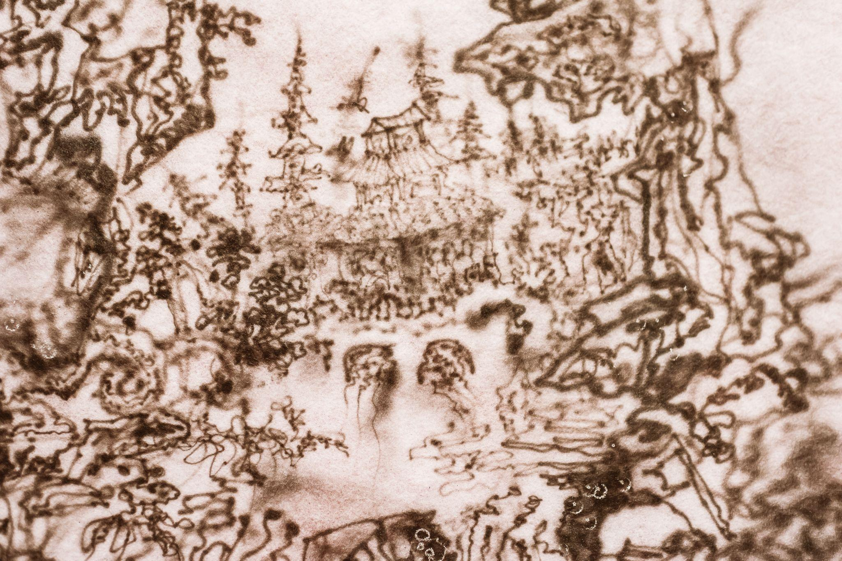
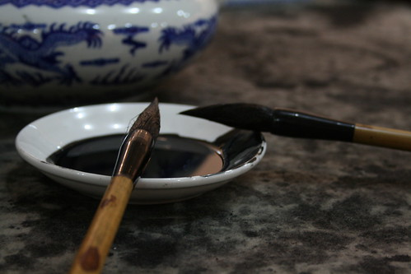
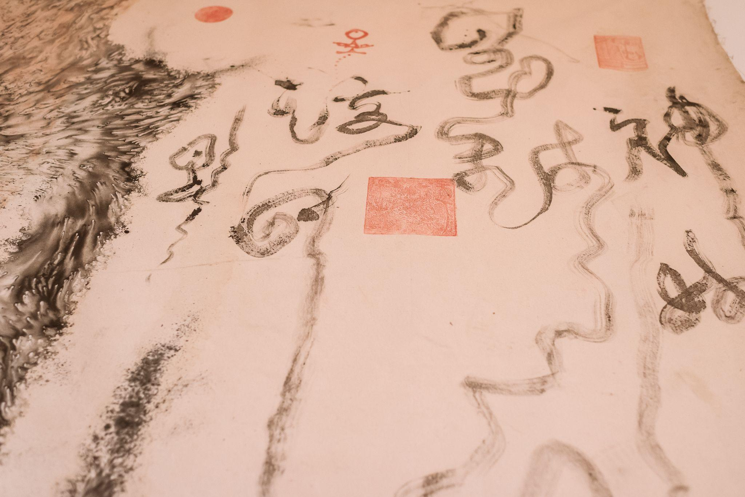
Master Shen-Long creates textures using different ink marks and brushstrokes.
Example of brush and ink
Artwork photos by Jessica Harrington, 2021

Slide 9
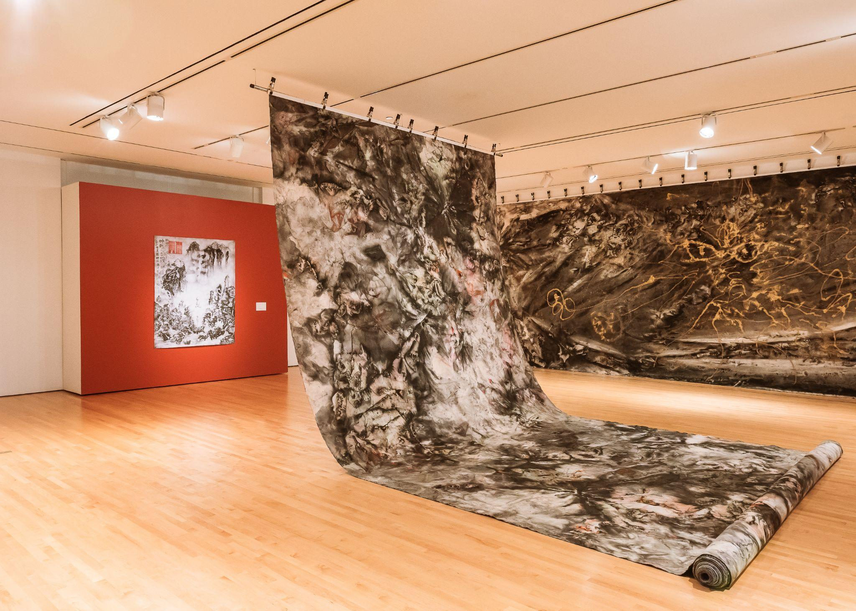
Before we zoom in and look at more textures, let’s look at how large Master Shen-Long’s artworks are:
Artwork photos by Jessica Harrington, 2021

Slide 10
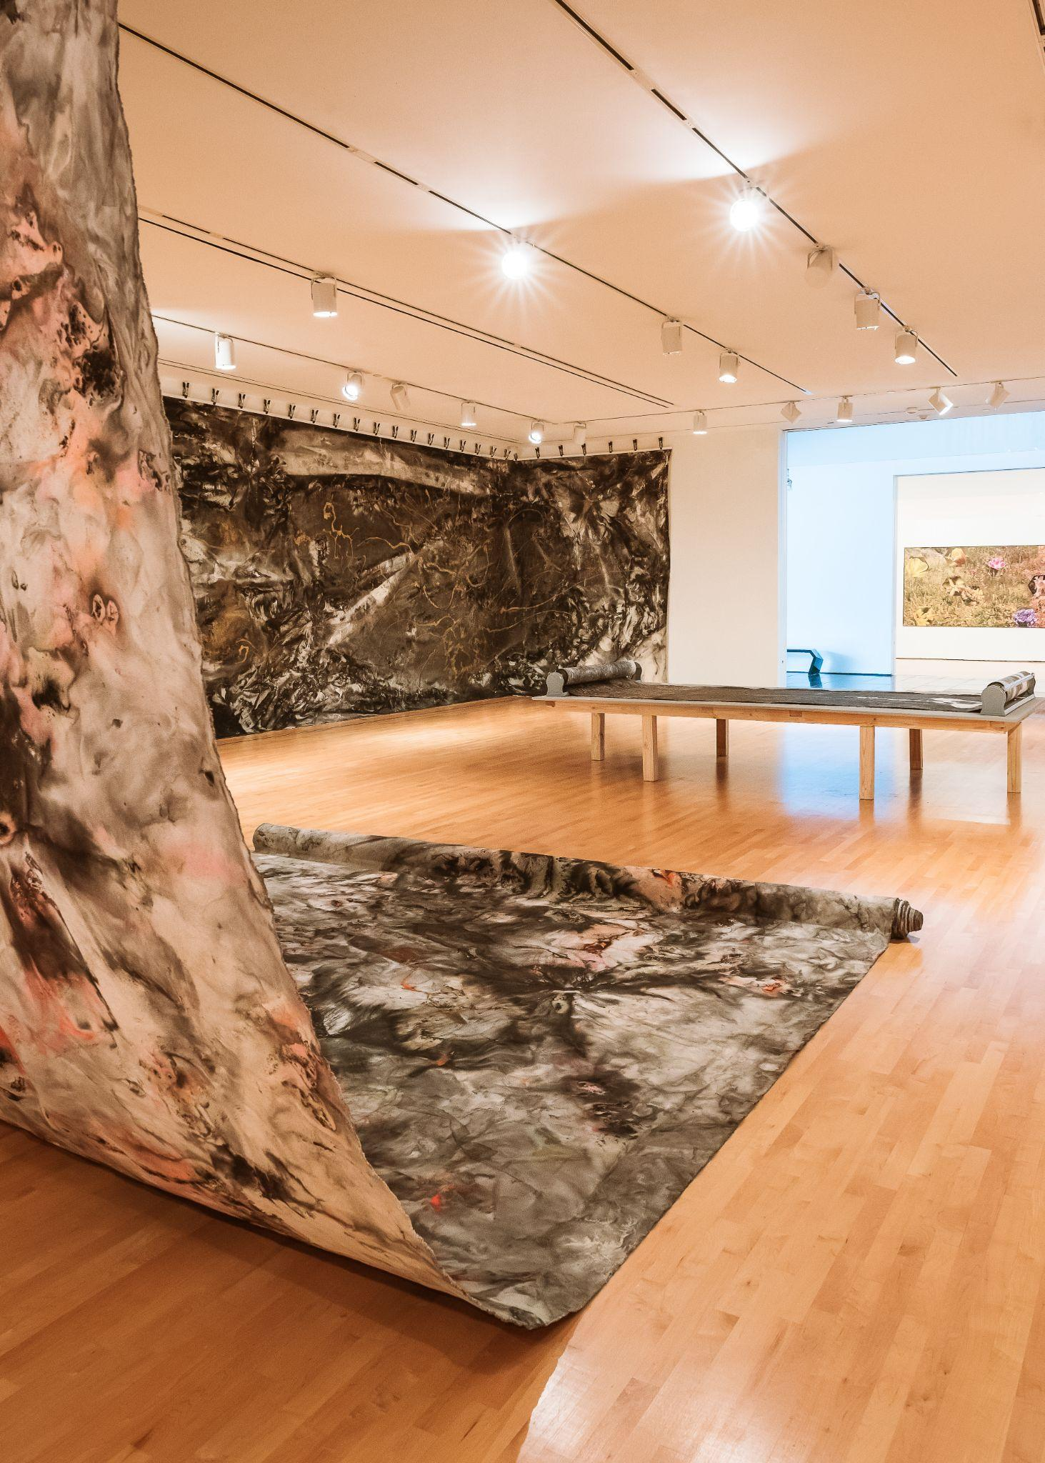
Many of Master Shen-Long’s artworks are wall-sized and are double sided.
When you walk into the gallery space you are surrounded by different textures and colors.
Photo by Jessica Harrington, 2021

Slide 11
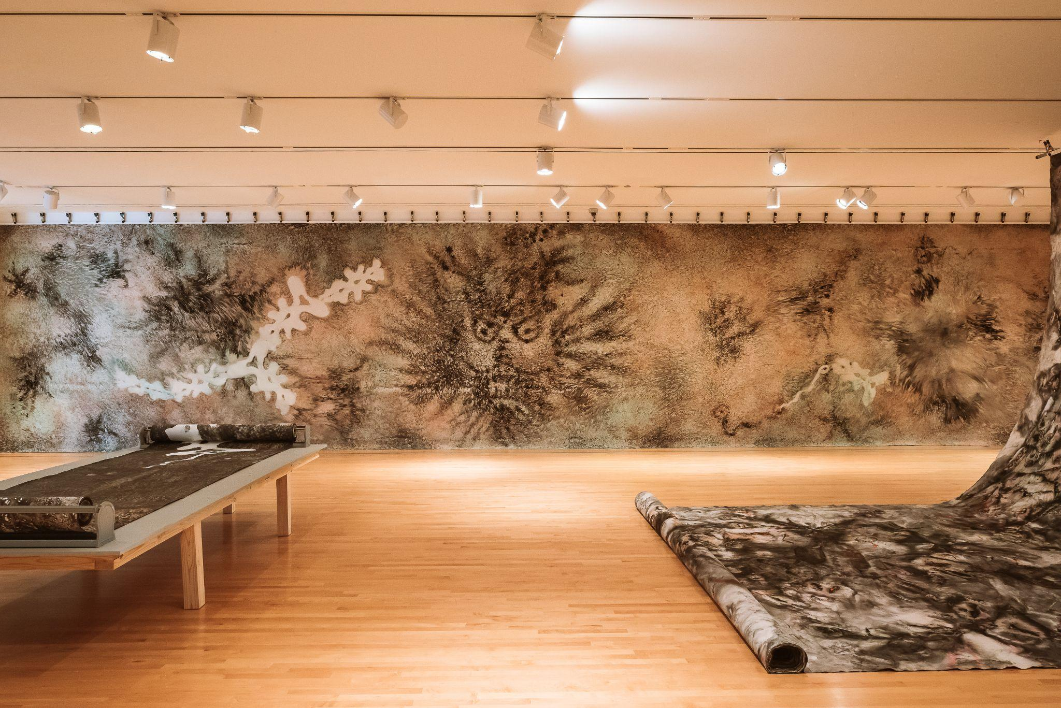
Photo by Jessica Harrington, 2021

Slide 12
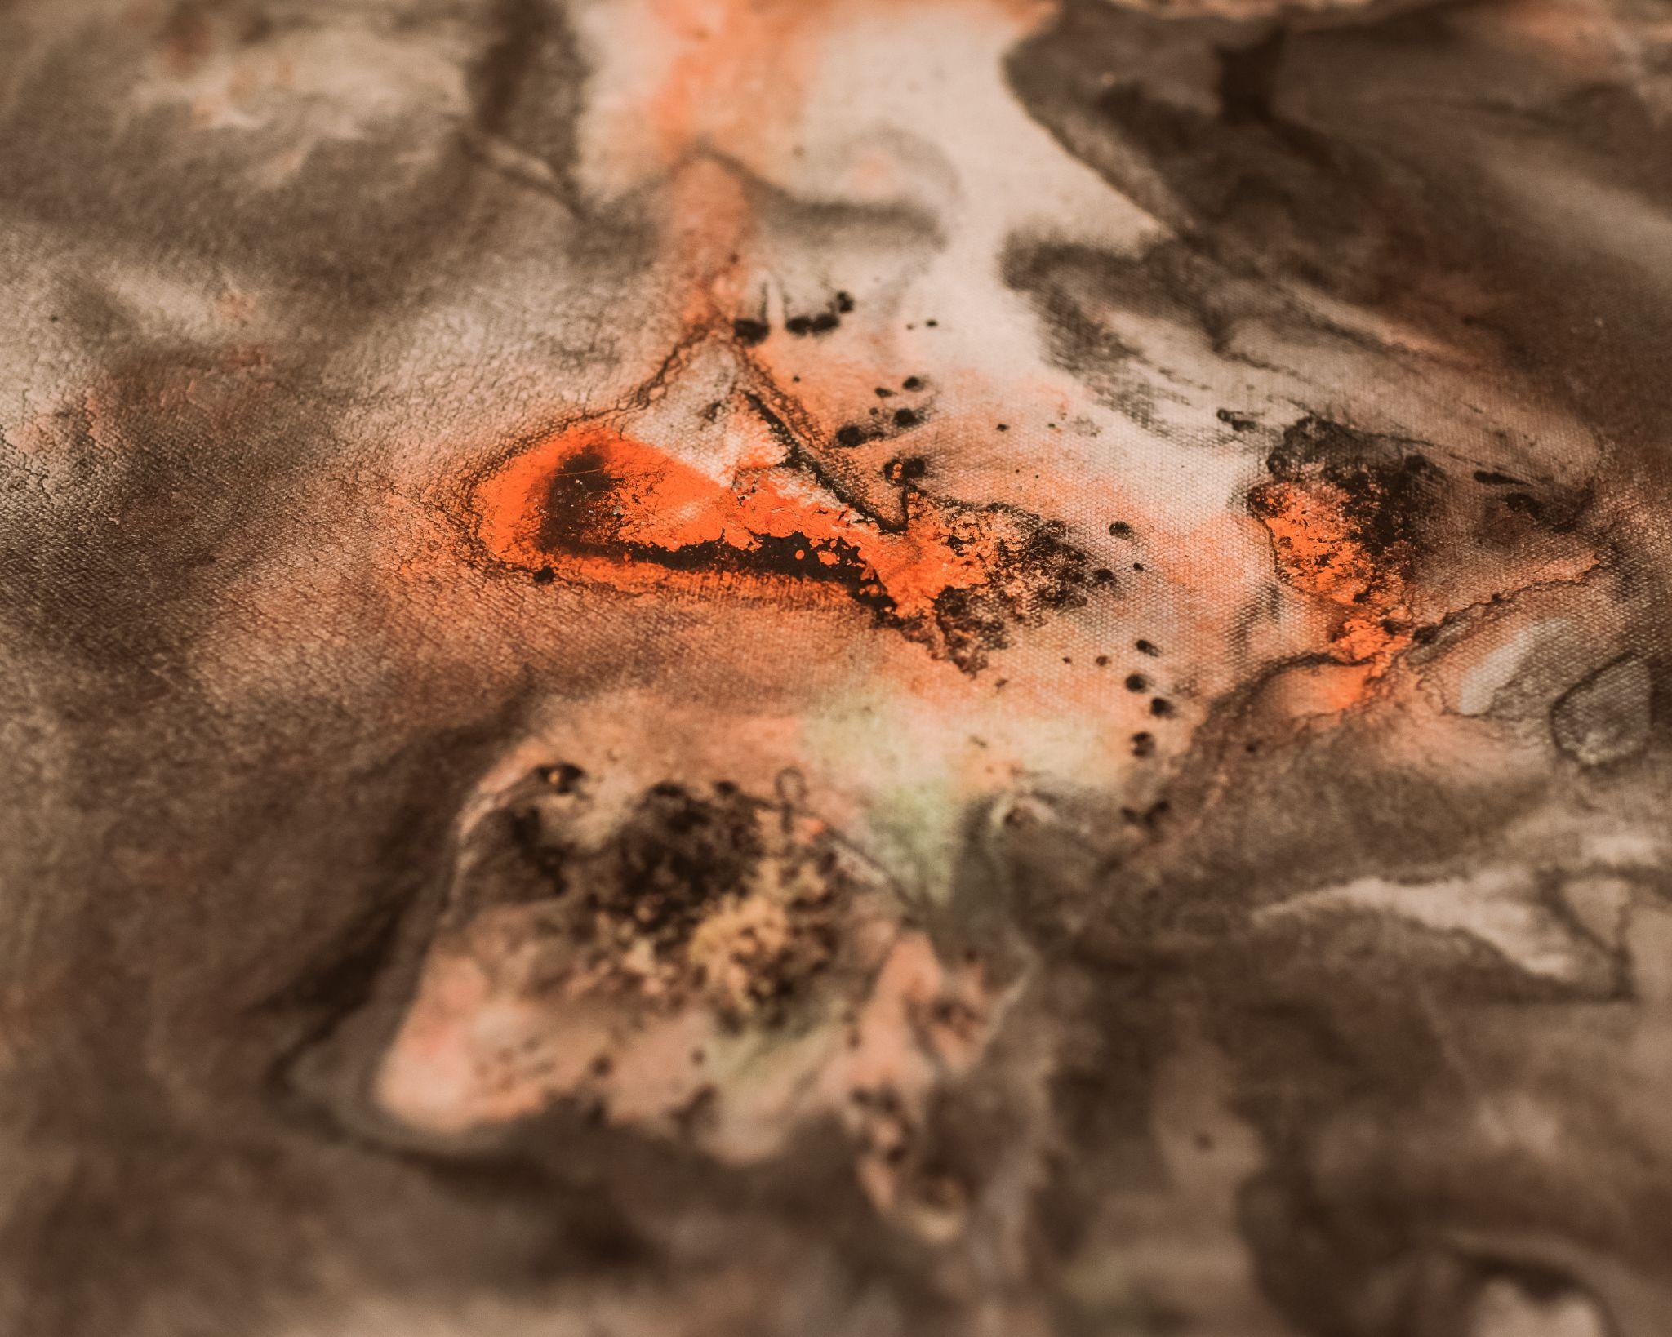
What different textures do you see?
Photos by Jessica Harrington, 2021

Slide 13
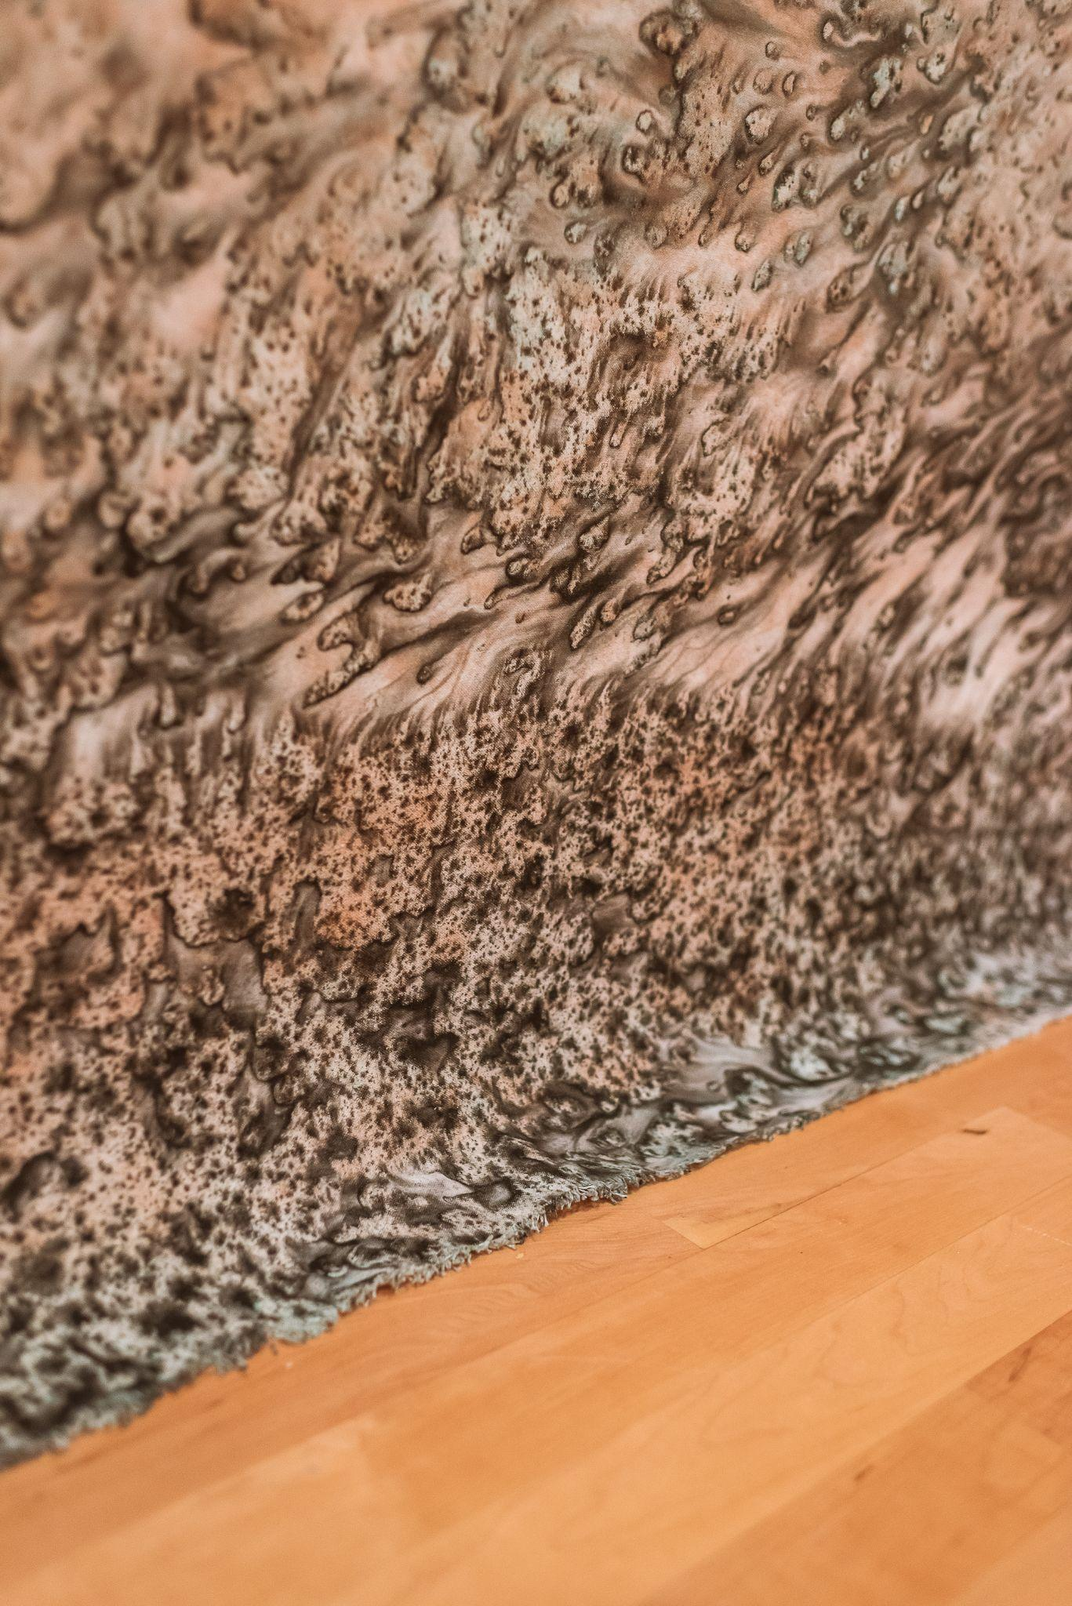
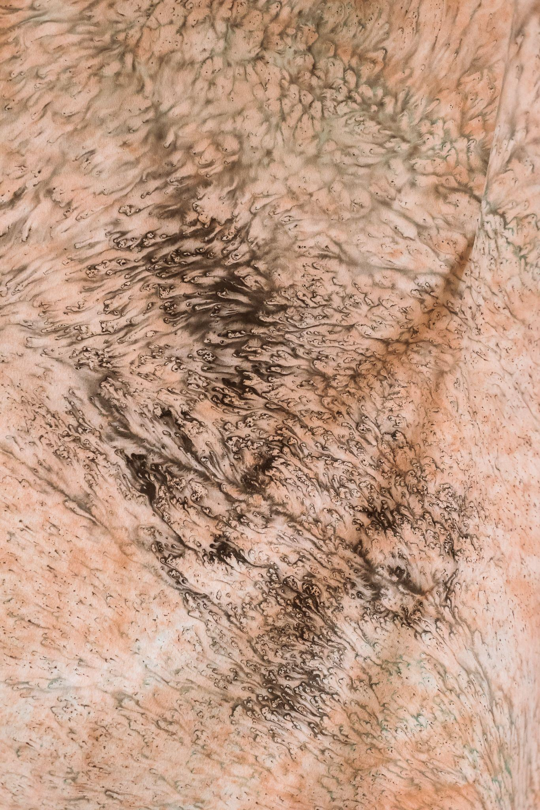
Photos by Jessica Harrington, 2021

Slide 14
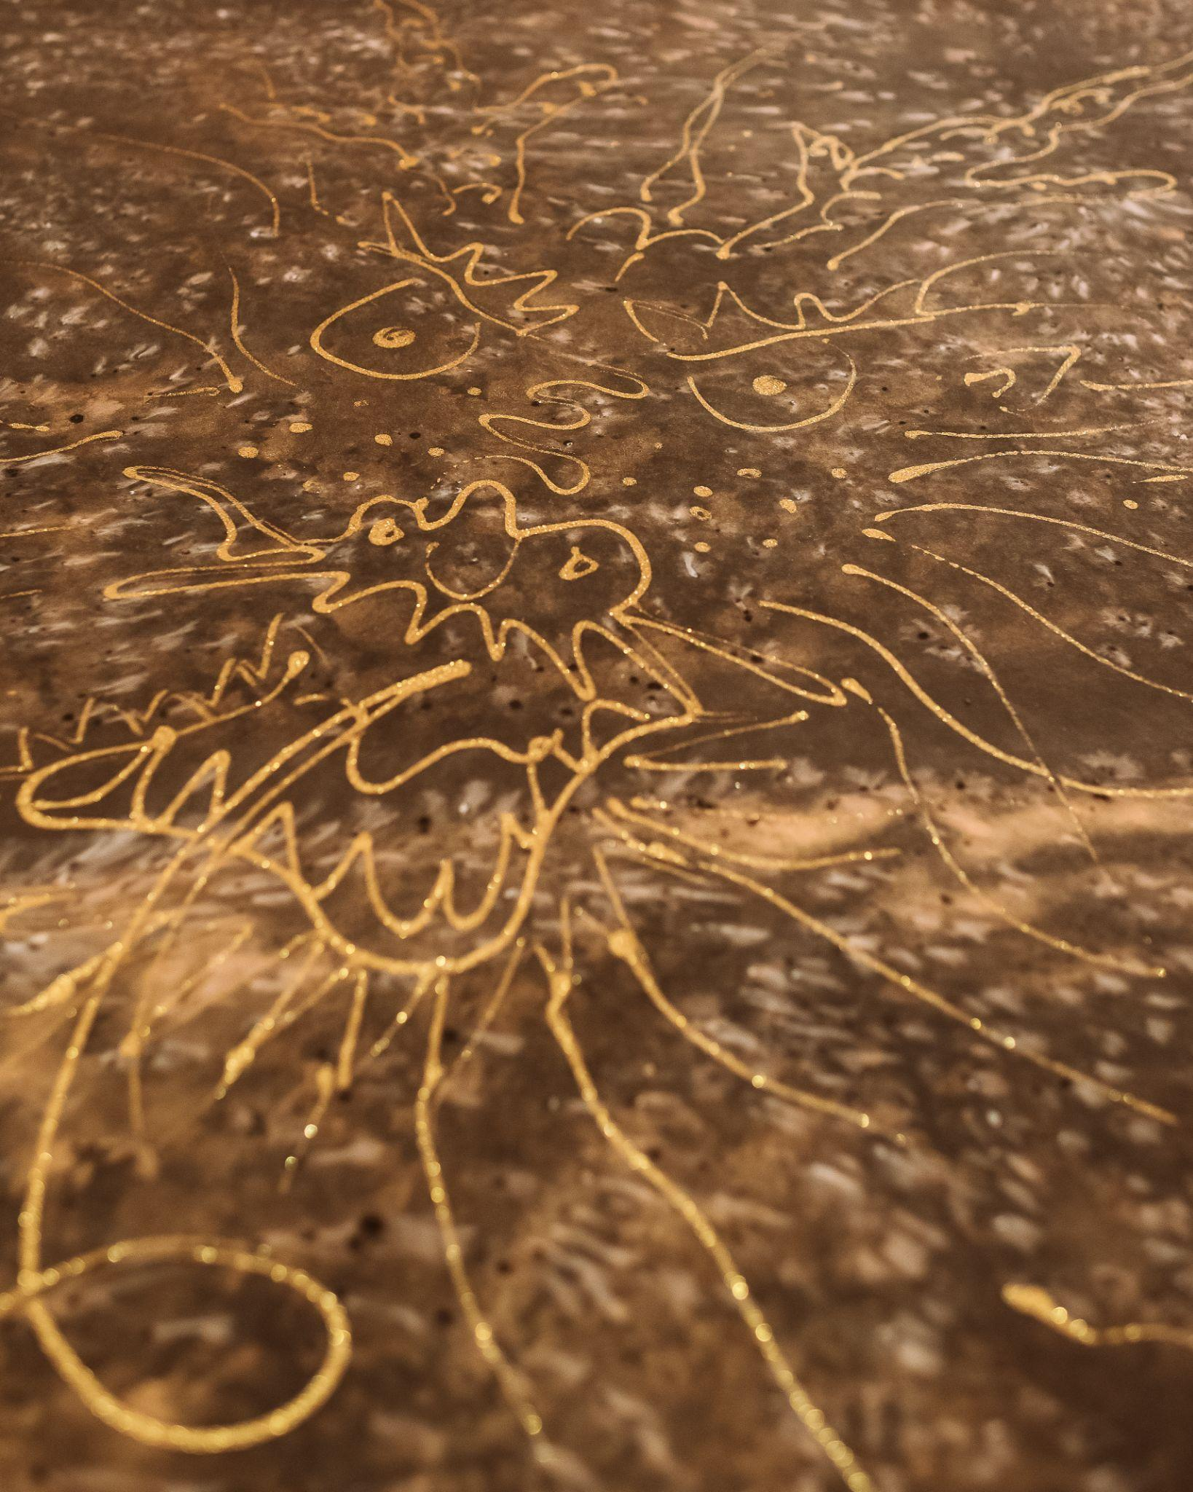
Photos by Jessica Harrington, 2021

Slide 15
Photo by Jessica Harrington, 2021

Slide 16
Visit the museum to see the exhibition Universe of the Mind: Master Shen-Long on view
from July 20, 2021-January 22, 2022.

